Slide 1

Dynamic memristors
FOR NEUROMORPHIC RESERVOIR COMPUTING
Maria Gragera Garces,
16th of November 2023
University of Bath

Slide 2
AGENDA
Neuromorphic computing
Neuromorphic reservoir computing
Dynamic memristors
A use case: of dynamic memristors in neuromorphic computing
The state of the art & it’s limitations

Slide 3
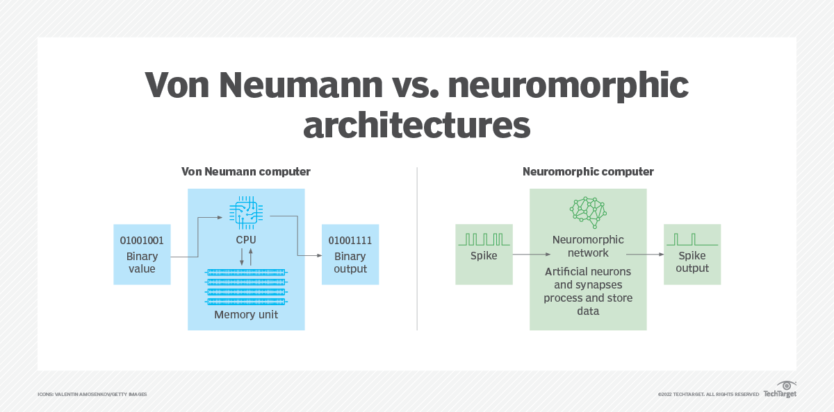
NEUROMORPHIC COMPUTING
Neuromorphic computing imitates neuron networks in the human brain and nervous system.
The most common form of neuromorphic hardware is the spiking neural network (SNN): where nodes (spiking neurons), process and hold data.

Slide 4
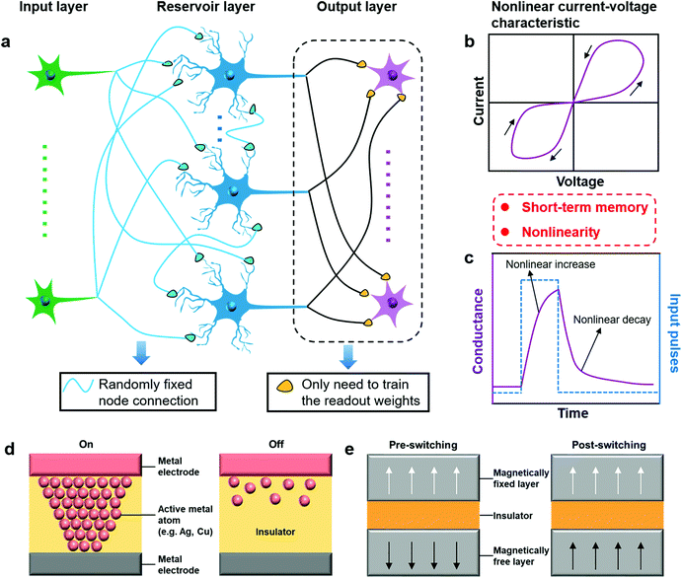
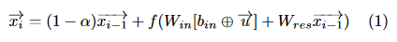
RESERVOIR COMPUTING
Is a neuromorphic computing-inspired recurrent neural network, capable of fast and energy-efficient temporal data analysis and prediction.
Eco-state networks
Type of reservoir computer that uses a recurrent neural network with a sparsely connected hidden layer (with low connectivity).
Fig 1.a) - CAO, Jie, et al. Emerging dynamic memristors for neuromorphic reservoir computing

Slide 5
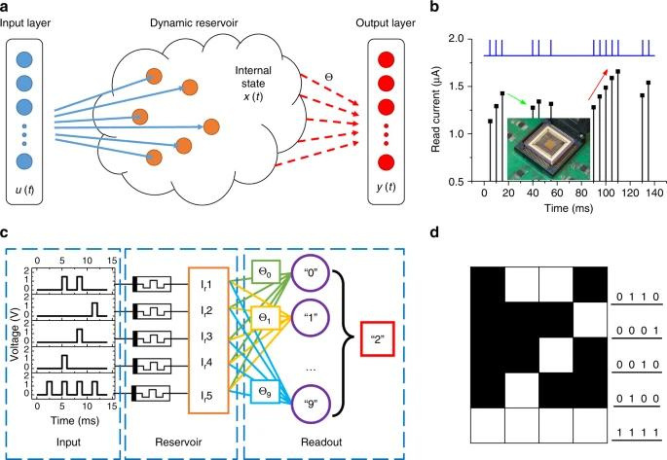
DYNAMIC RESERVOIR
Hardware implementations of RC systems can significantly reduce computing time and energy.
However, current physical devices pose challenges.
Dynamic memristors offer a promising solution, leveraging their:
quick, low-energy switching,
nonlinear dynamics,
and short-term memory capabilities.
Fig 1.a) -DU, Chao, et al. Reservoir computing using dynamic memristors for temporal information processing

Slide 6
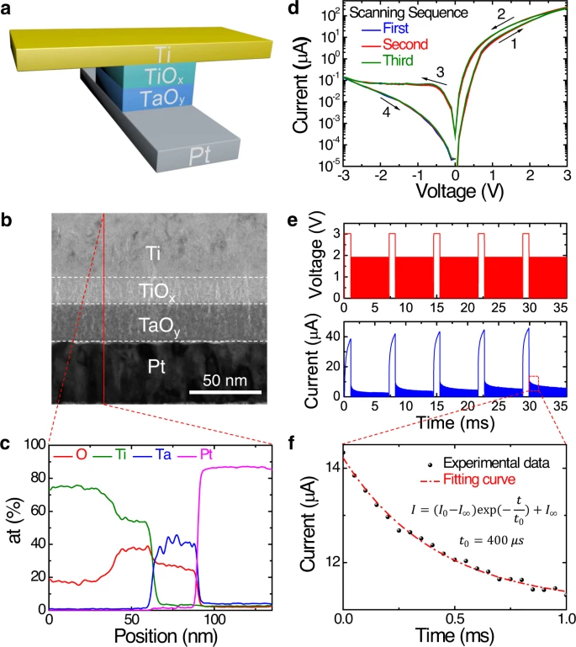
DYNAMIC MEMRISTORS
Through an example
Ti = Titanium
TiOx = Titanium Oxide
TaOy = Tantalum Oxide
Pl = Platinum
a) Vertically stacked cross-point structure
b) Cross-section transmission electron microscope image
c) Standard I–V memristor hysteresis curves ( over multiple cycles)
Fig 1 - ZHONG, Yanan, et al. Dynamic memristor-based reservoir computing for high-efficiency temporal signal processing

Slide 7
OUTPUT OF THE DYNAMIC MEMRISTOR IS NOT ONLY DEPENDENT ON THE CURRENT INPUT BUT ALSO RELIES ON THE HISTORY OF THE INPUT SIGNAL

Slide 8
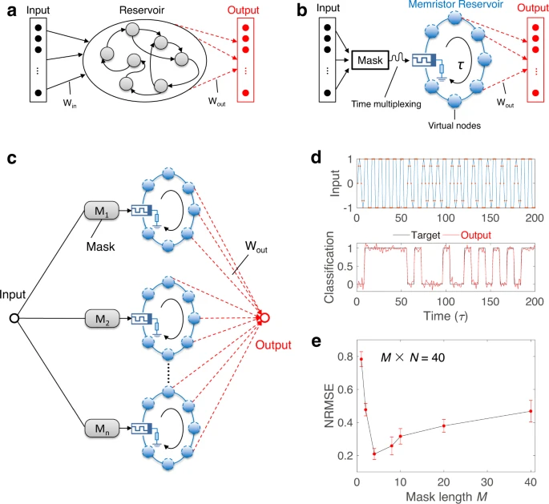
MEMRISTOR BASED RESERVOIRS
Memristor's short-term memory and I–V nonlinearity enables it to effectively implement neural networks with recursive connections.
Fig 2 - ZHONG, Yanan, et al. Dynamic memristor-based reservoir computing for high-efficiency temporal signal processing

Slide 9
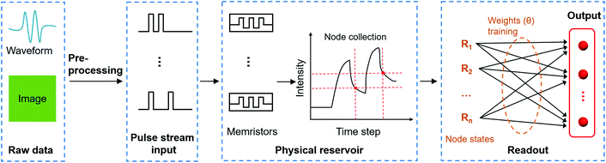
SCHEMATIC OF AN INFORMATION PROCESSING FLOW CHART USING A DYNAMIC MEMRISTOR-BASED RC SYSTEM
Fig 2 - CAO, Jie, et al. Emerging dynamic memristors for neuromorphic reservoir computing

Slide 10
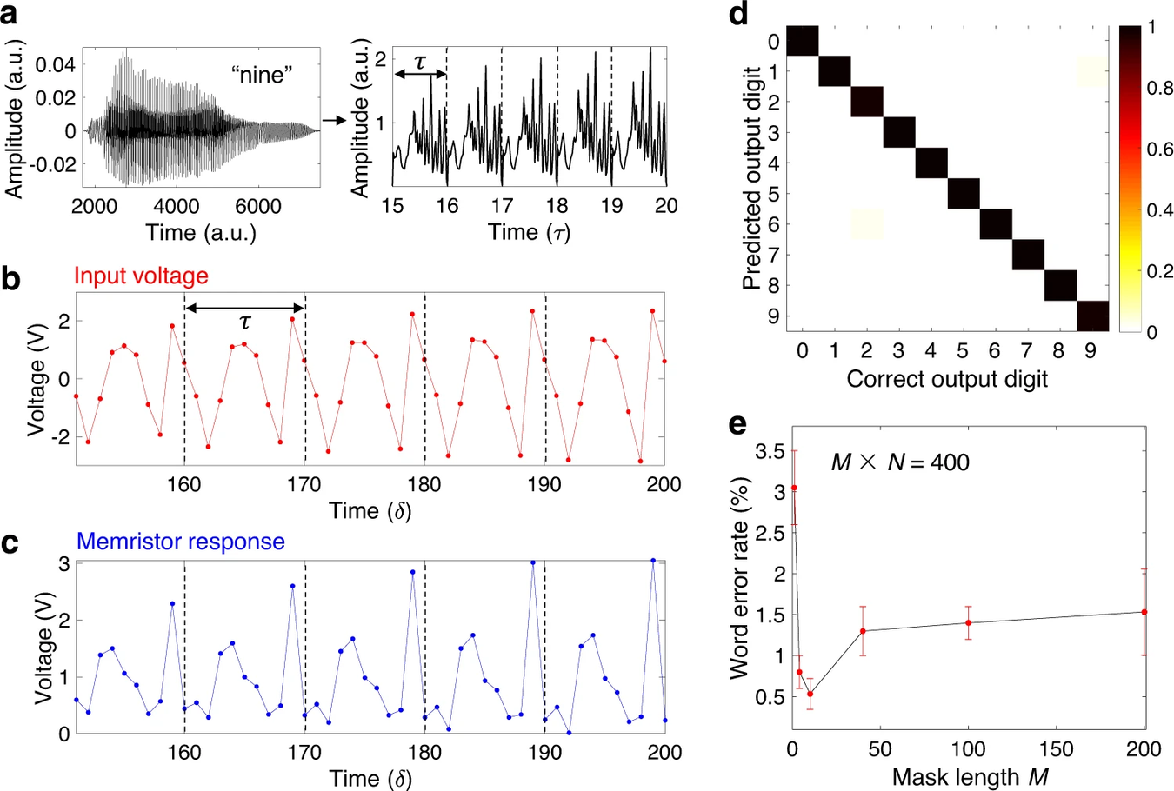
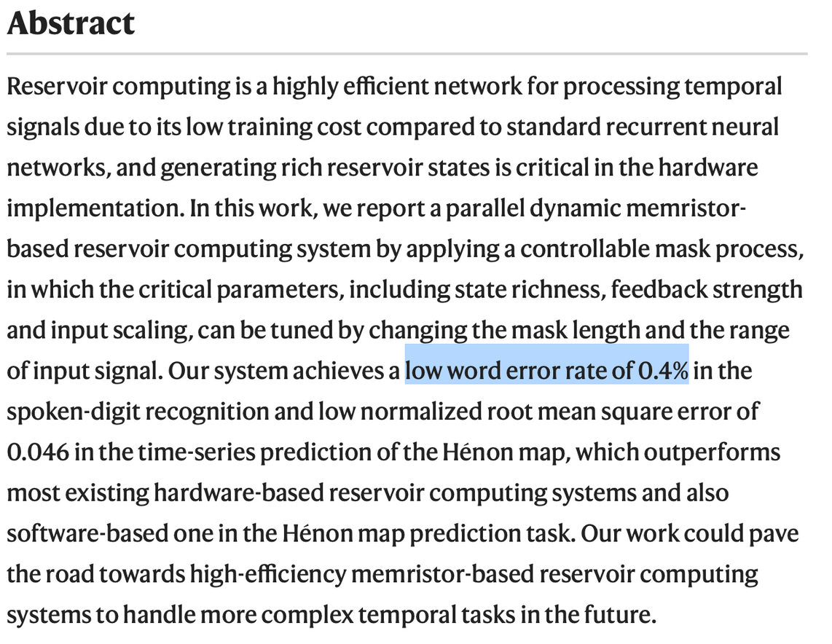
USE CASE: SPOKEN-DIGIT RECOGNITION
Fig 3 - ZHONG, Yanan, et al. Dynamic memristor-based reservoir computing for high-efficiency temporal signal processing

Slide 11
PATH TO IMPLEMENTATION
2008
2011
2015
2017
+ 2020
Discovery of Memristive Dynamics
Memristors in Neuromorphic Circuits
Memristor-Based Neuromorphic Systems
Advances in Memristor Technology
Continued Research and Integration
The term "memristor" was coined by Leon Chua in 1971, but it wasn't until 2008 that researchers, including Stan Williams at Hewlett-Packard Labs, demonstrated the existence of dynamic memristive behavior in certain nanoscale materials.
Researchers began to explore the use of memristors in neuromorphic circuits for their ability to mimic synapse-like behavior. Memristors were recognized for their potential in implementing synaptic plasticity, a key aspect of biological learning and memory.
Several studies showcased the use of dynamic memristors in building neuromorphic systems. Researchers demonstrated how memristors could be integrated into hardware platforms to replicate synaptic functionality.
Ongoing research led to advancements in memristor technology, including improvements in materials, fabrication processes, and scalability. These developments enhanced the reliability and performance of memristors, making them more suitable for use in large-scale neuromorphic computing systems.
Research and development in dynamic memristors for neuromorphic computing continue to advance. As of my last knowledge update in January 2022, efforts are ongoing to optimize memristor-based architectures for various neuromorphic applications, including reservoir computing.

Slide 12
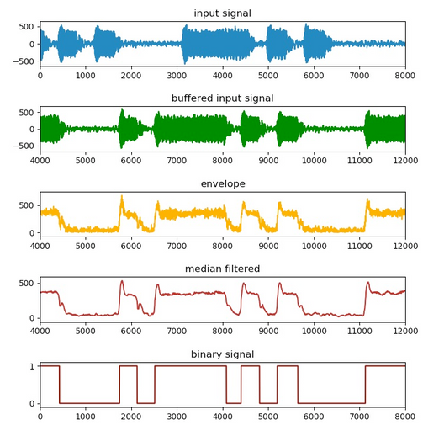


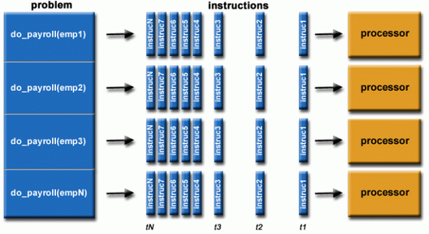
BENEFITS OF DYNAMIC MEMRISTORS FOR NRC
Image from HOC Introduction to Parallel Computing
Parallelism
Low Power Consumption
Fault Tolerance
Image from Spinor Lab
Real-time Signal Processing
The inherent parallel processing capabilities of dynamic memristors, which can simultaneously adapt resistance, facilitate efficient emulation of synaptic connections. This parallelism optimizes computational efficiency, aligning with the parallel processing observed in biological neural networks and advancing the capabilities of neuromorphic architectures.
The dynamic memristors property to alter resistance and emulate synaptic connections with minimal energy requirements contributes to significant power efficiency. This low-power characteristic is essential for creating energy-efficient neuromorphic computing architectures, aligning with the growing demand for sustainable and resource-conscious computing solutions.
Memristors can exhibit fault-tolerant behavior, as the information is distributed across the network. This property can enhance the robustness of neuromorphic systems against hardware failures or variations in device characteristics.
Dynamic memristors adjust resistance based on voltage history, enabling efficient synaptic emulation. This real-time processing swiftly adapts to dynamic synaptic weights, crucial for achieving parallel processing and bio-inspired learning in neuromorphic architectures.

Slide 13
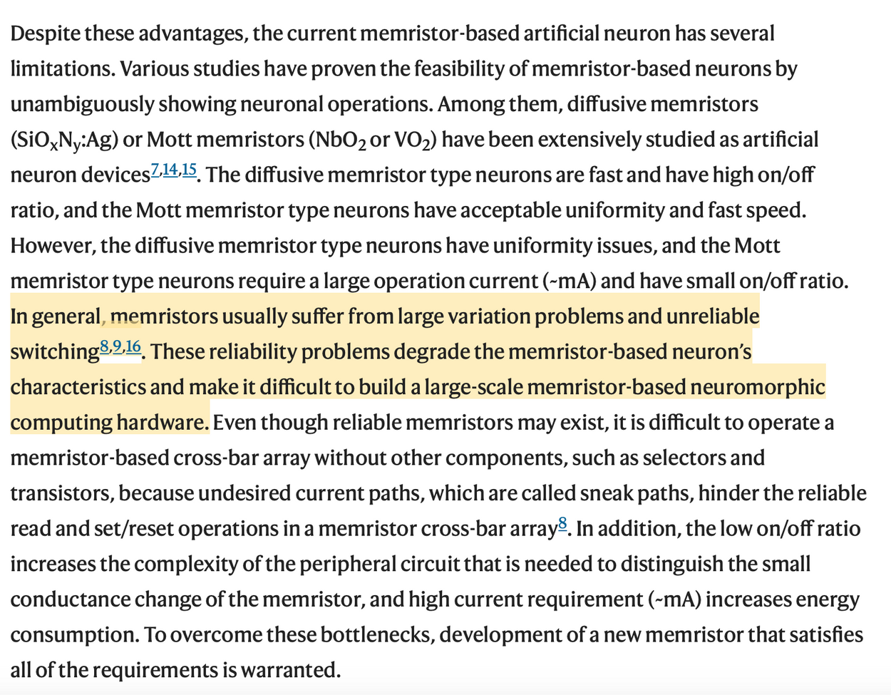
LIMITATIONS OF THE STATE OF THE ART
Manufacturing
Understanding
challenges
of Biological Systems
Consistency
Endurance
Reliability
Scalability
Neuroscience
Programming and training challenges
Integration
Applications
with Existing Technologies
and Robustness
Still in young research stages.
Compatibility issues
Software adaptation
Benchmarking
Standardisations
Introduction - PARK, See-On, et al. Experimental demonstration of highly reliable dynamic memristor for artificial neuron and neuromorphic computing

Slide 14
Q&A
THANK YOU!
Maria Gragera Garces,
16th of November 2023
University of Bath

Slide 15
Additional slides

Slide 16
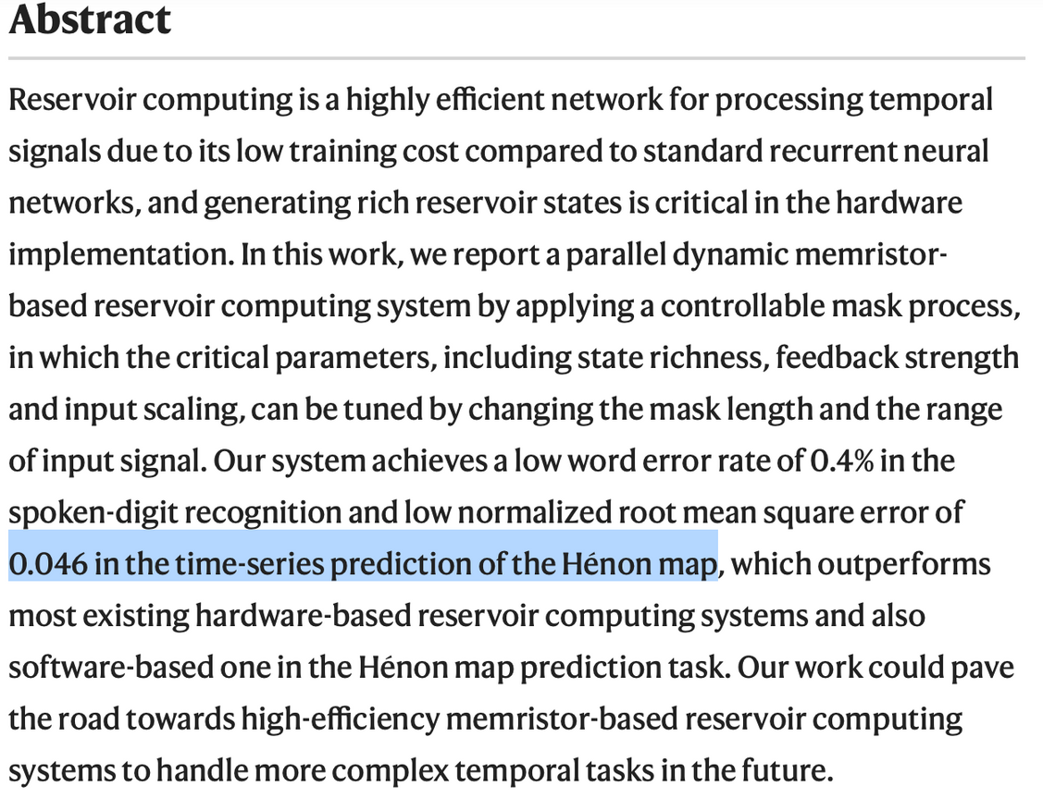
ANOTHER USE CASE
Fig 3 - ZHONG, Yanan, et al. Dynamic memristor-based reservoir computing for high-efficiency temporal signal processing

Slide 17
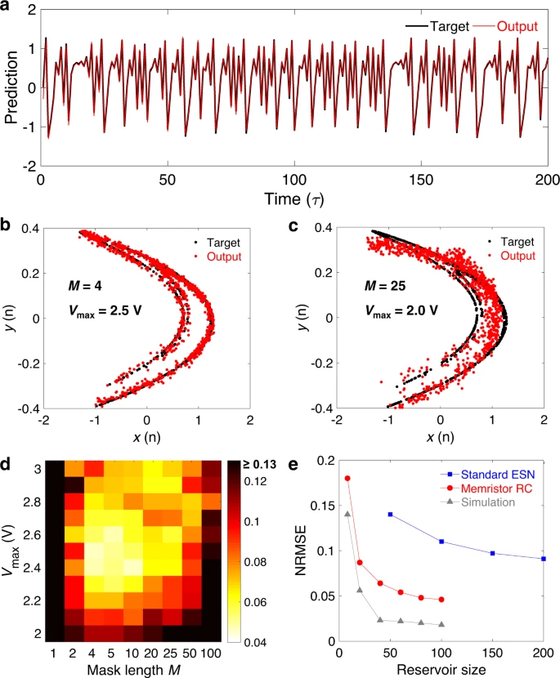
a) The predicted results obtained by the memristor-based parallel RC system, where the black line represents the ideal target and the red line represents the experimental output from the RC system. Test parameters are set to be M = 4, N = 25, Vmax = 2.5 V and Vmin = −0.8 V. b, c 2-D display of the predicted results under different test parameters, where the M and Vmax in
b and c) are 4, 2.5 V and 25, 2.0 V, respectively. Vmin and the total reservoir size (M × N) remain unchanged at −0.8 V and 100, respectively.
d) The prediction error varies with the two test parameters M (1–100) and Vmax (2.0–3.0 V), where the color bar represents the NRMSE (values >0.13 are shown in black in the figure). Vmin and M × N remain unchanged.
e) The NRMSE changes with the reservoir size in different RC systems including the standard ESN (results in ref. 40), memristor-based parallel RC, and software-simulated one. In both experiment and simulation, the mask length remains constant at 4, and the total reservoir size is adjusted by changing the number of parallel reservoirs N.
Fig 3 - ZHONG, Yanan, et al. Dynamic memristor-based reservoir computing for high-efficiency temporal signal processing

Slide 18
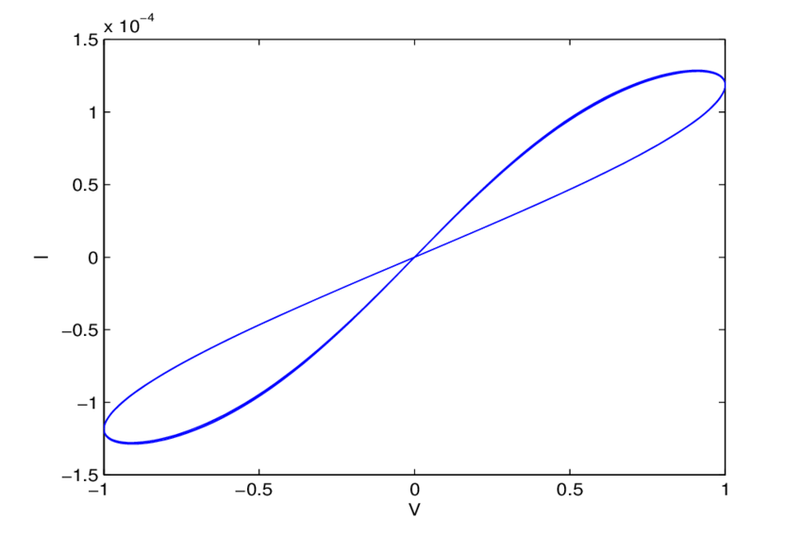
MEMRISTOR HYSTERESIS LOOPS
Typical i-v characteristic of memristor [1, 22]. The pinched hysteresis loop is due to the nonlinear relationship between the memristance current and voltage. The memristor exhibits the feature of pinched hysteresis, which means that a lag occurs between the application and the removal of a field and its subsequent effect, just as the neurons in the human brain have.
Exponential stability analysis of memristor-based recurrent neural networks with time-varying delays - Shiping Wen,et. al

